Slide 1

Data Protection & Privacy
Anonymization of Time Series based on Shou et al. article of 2013
Lorenzo Grattarola

Slide 2




INDEX
Time Series data anonymization in literature
Shou et al. approach towards time series anonymization
Kapra algorithm implementation
Kapra vs Naive benchmarks

Slide 3
TIME SERIES DATA
The biggest challenge in anonymizing time series is balancing the privacy requirements and preserving both pattern and istant value loss.
{ QI }
{ SD }
General TS
ID | Name | A1 | … | AN | AS1 | AS2
istant values
Graph representation
trough
peak
mean

Slide 4
Two possible methods
Generalization
= (k,P)-Anonymity
Perturbative Methods
White noise
Correlated noise
In every k-group each time series must have at least P-1 time series with the same pattern
The anonymized dataset must be divided in Groups containing at least k time series with the same QI

Slide 5
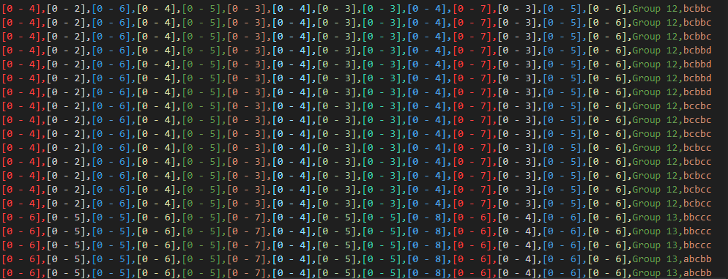
Example of a (15,3)-Anonymity
3
4
3
15
5

Slide 6
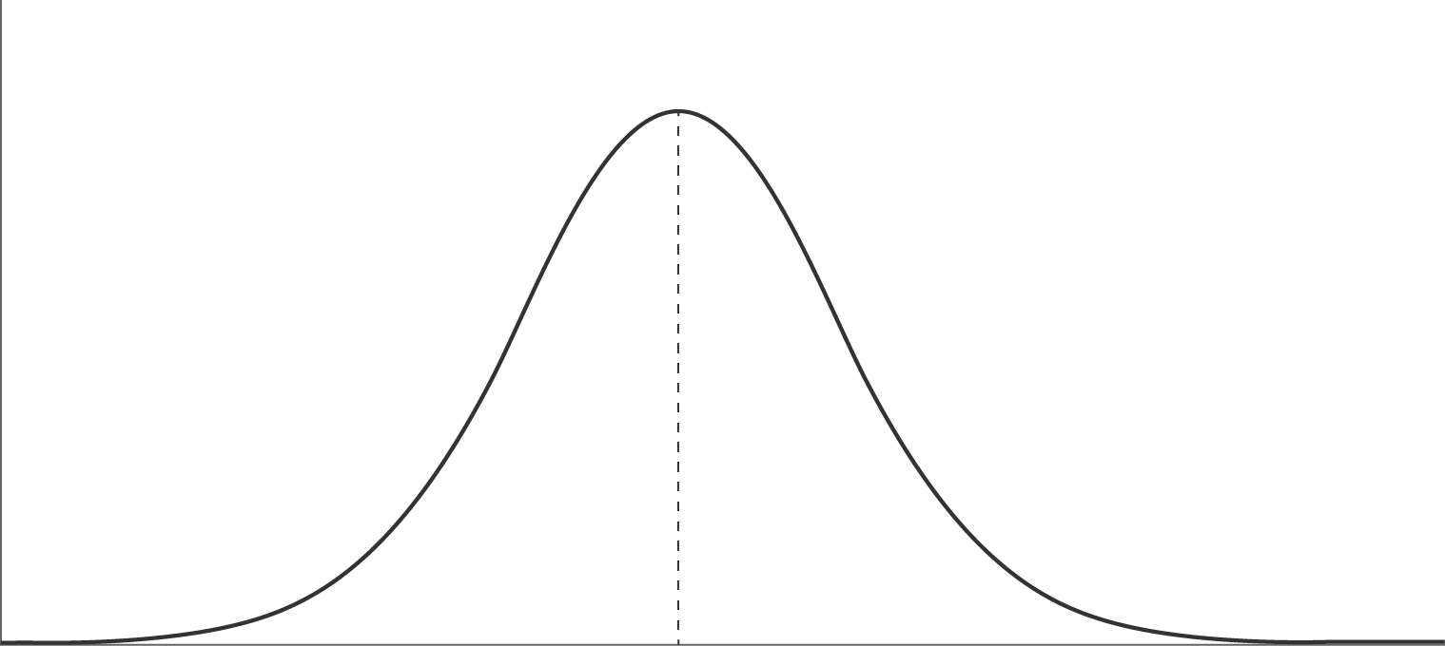
Supporting Pattern-Preserving Anonymization for Time-Series Data
Lidan Shou, Xuan Shang, Ke Chen, Gang Chen, and Chao Zhang
Pattern generation with SAX
The article firstly introduce the concept of (k,P)-Anonymity, justified by the inahbility of the general k-anonymiziation approach to deal with the presence of pattern-related QI elements.
TS:
0 | 4 | 5 | 2 | -4 | 3 | 6 | 3 | 2 | 6
New dimension(paa) = 4
The key idea is to link each time series with its own pattern, and then forcing each k-generalized group to have the P requirement w.r.t. to the pattern.
paa:
-0.3490 | -0.8725 | 0.5235 | 0.3839
-inf
-0.4307
0.4307
+inf
0
Alphabet cardinality = 3
{ a }{ b }{ c }
The article continues by giving two possible implementation of the (k,P)-Anonymity algorithm: Naive and Kapra.
Pr:
b | a | c | b

Slide 7
NAIVE
The initial Dataset gets divided in groups of at least K-elements. The approach is called «top-down» group formation and its main focus is to divide the initial ds with a similarity criteria.
So that each K-group envolopes time series similar to each other.
Then each k-group gets divided to respect the P requirement.
Initial Dataset

Slide 8
KAPRA
After this, the P-subgroups get merged to satisfy the k-requirement
In this case, the initial dataset get divided into subgroups accordingly with the P requirement

Slide 9



KAPRA phase one
«Create tree»
aaaa
The tree creation process starts from the root containing all time series with pattern «aaaa», at each iteration the algorithm enlarges the cardinality of the alphabet of each node:
if a specific pattern has more or equal than P time series then the upgrade is accepted, and the group is added to the good-leaf-nodes.
aabc
aacb
aacc
acab
acac
abac
abab
….
….
….
….
….
….
….
….
….
Now, if the sum of the size of the tentative bad-nodes is greater or equal than P, the time series will be merged in a node, and that node will be labelled as «good-leaf».
aabb
abab
aabb
…
aaab
[aacb] = {ts1,tsP-2}
aabb
aabb
[aabc] = {ts1,ts2,ts3,...,tsP}
[aacc] = {ts1,ts2}
[aacb] = {ts1,ts2,tsP-1}
bbaa
Otherwise, each «bad» pattern will generate a «bad-leaf»
Otherwise it is labelled as «tentative bad-node»

Slide 10

KAPRA phase two
«Recycle bad-leaves»
Since there are no more nodes to merge and we reached the minimum level (1), these time series will be permanently supressed
acac
abab
aaaa
acca
abba
Generalize every highest level (highest levels -1)
abba
aaaa
abba
ADDED TO GOOD LEAVES
abba
(Assuming this merged node has at least P elements in it)
(Assuming this merged node has less than P elements)
aaaa
aaaa
aaaa

Slide 11
KAPRA phase three
«Group Formation»
Then we pick the leaf with the smallest value loss and we merge it with an other, in such a way that the second one will produce the smallest value loss possible with the first one. Thus this is again achieved through «similiarity».
After doing this if the merged node has at least k elements it will be removed. Otherwise we will search for an other similar node to be added.
PGL
Size >= 2*P
First all the leaves with size greater or equal than 2P will be splitted using a similiarity criteria w.r.t. the time series’ istant values.
s1
smin

Slide 12
KAPRA vs NAIVE
I conducted 10 experiments with 2 datasets.
So 20 experiments per algorithm, 40 in total.
Sales_Transaction_Dataset_Weekly_Final (811,51)
exoStars (2000,1000)
[Increasing K] = [(5,5),(7,5),(10,5),(20,5),(40,5)]
[Increasing P] = [(15,3),(15,5),(15,6),(15,7),(15,8)]

Slide 13
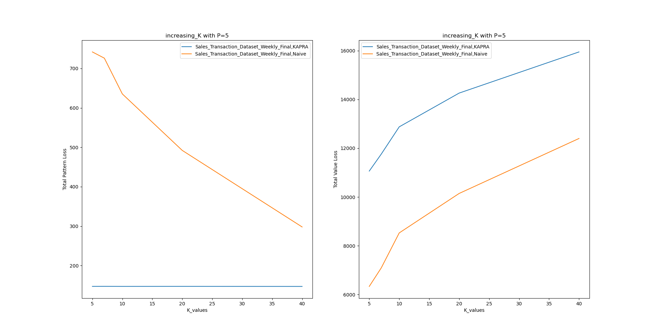
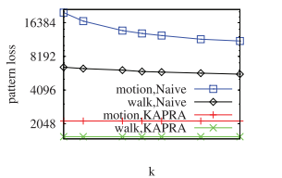
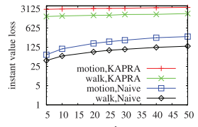
Increasing K with P = 5

Slide 14
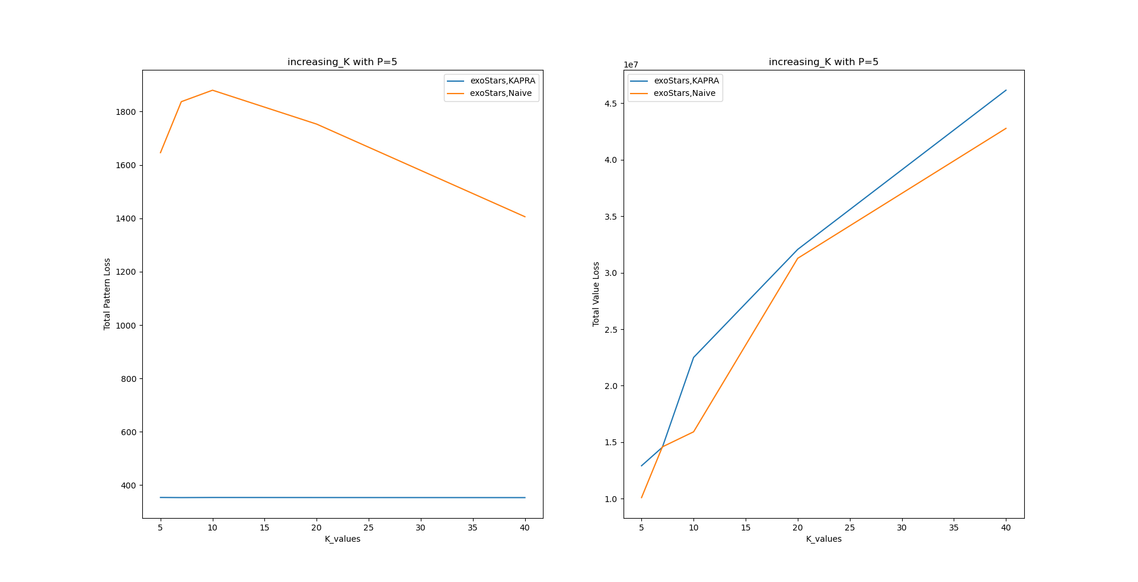
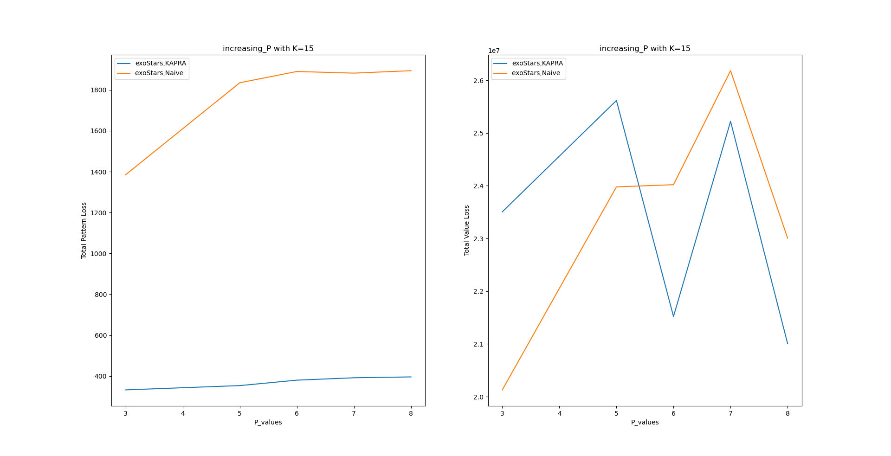
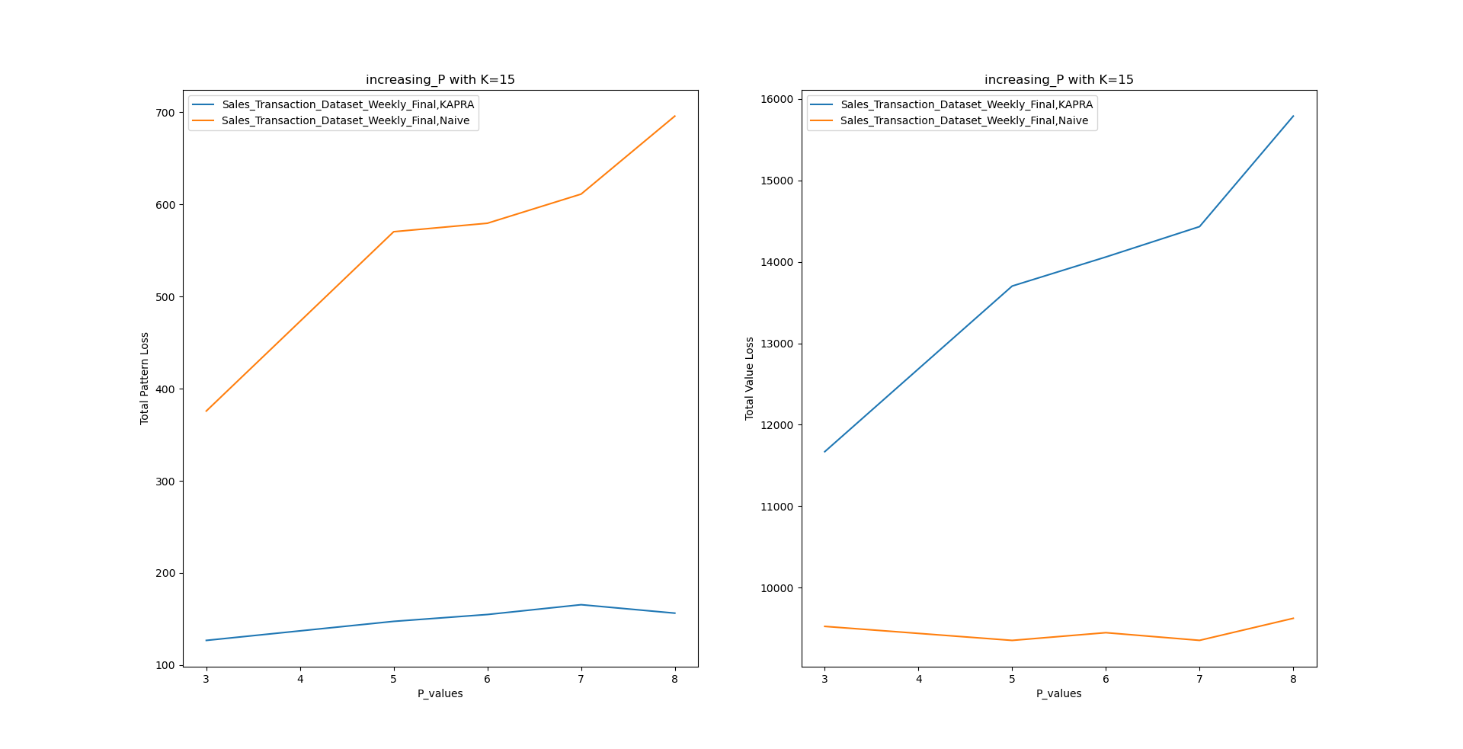
Increasing K with P = 5
exoStars
Sales
Increasing P with K = 15
KAPRA
NAIVE

Slide 15
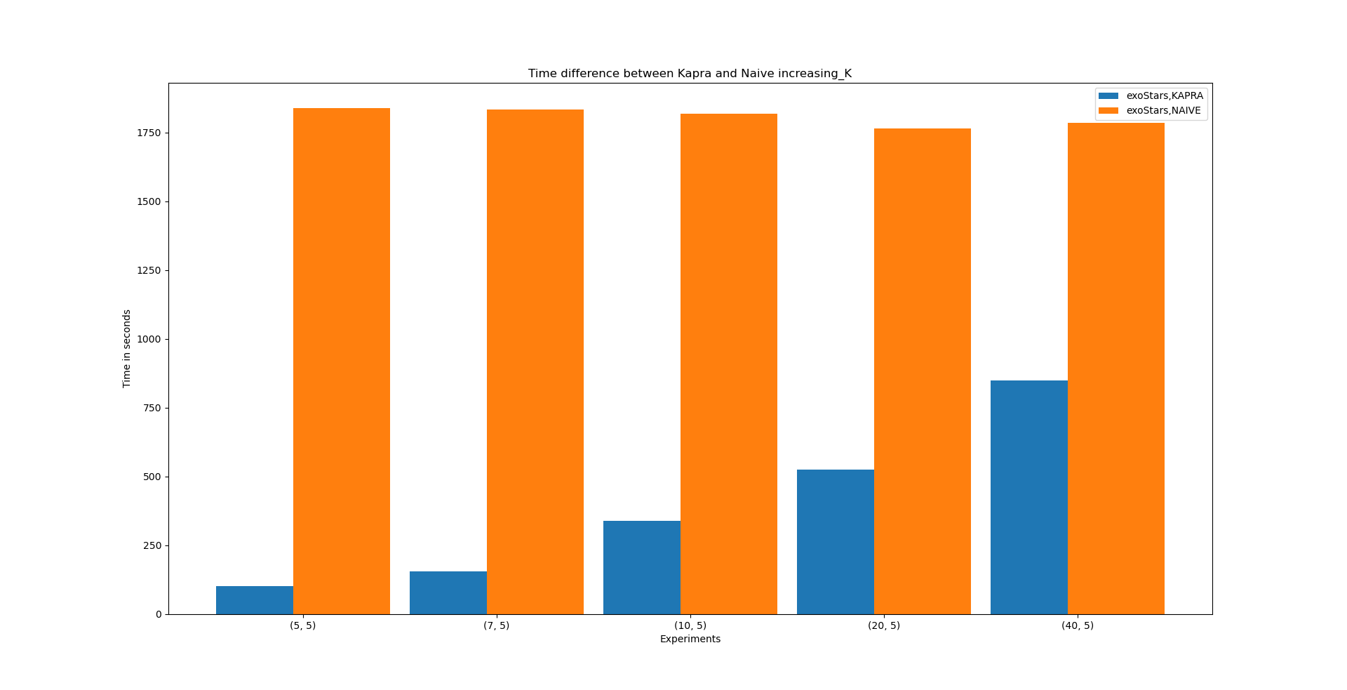
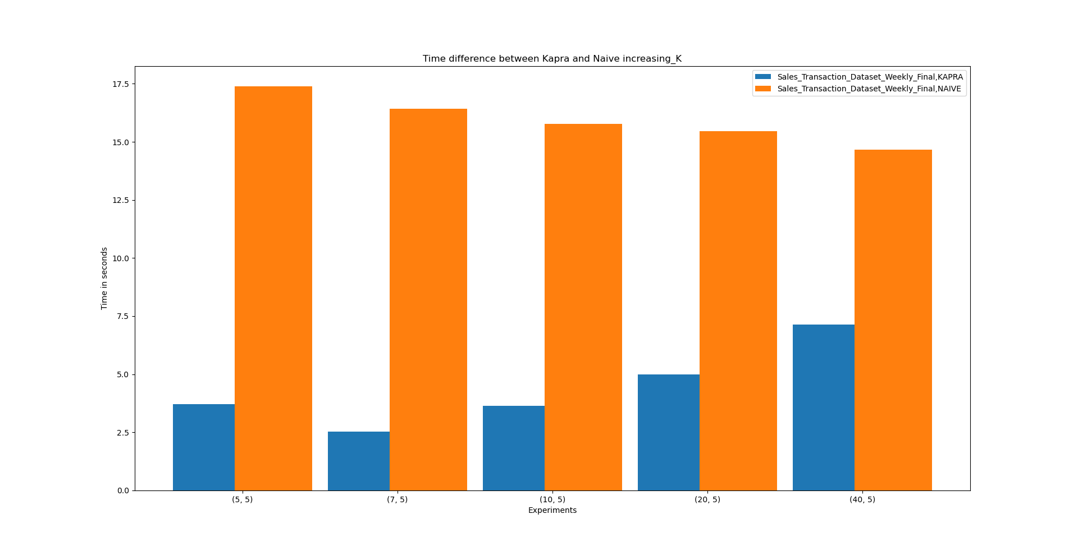
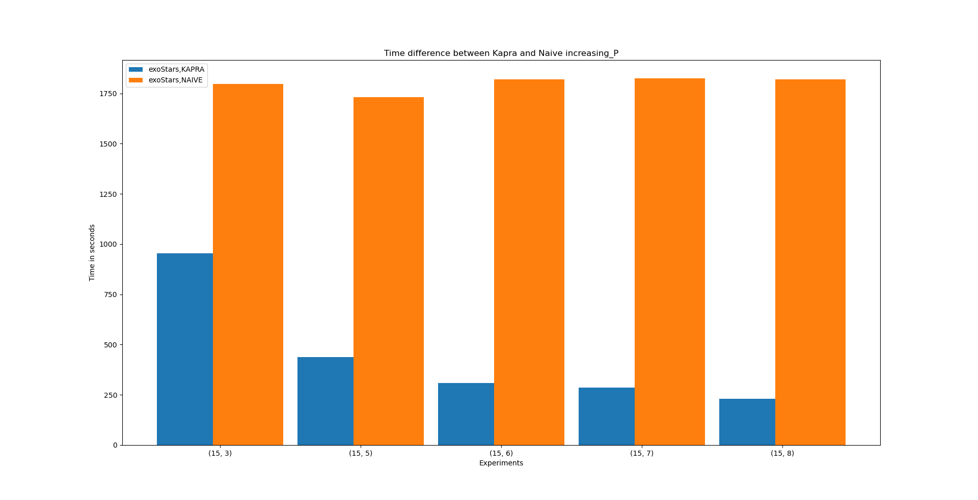
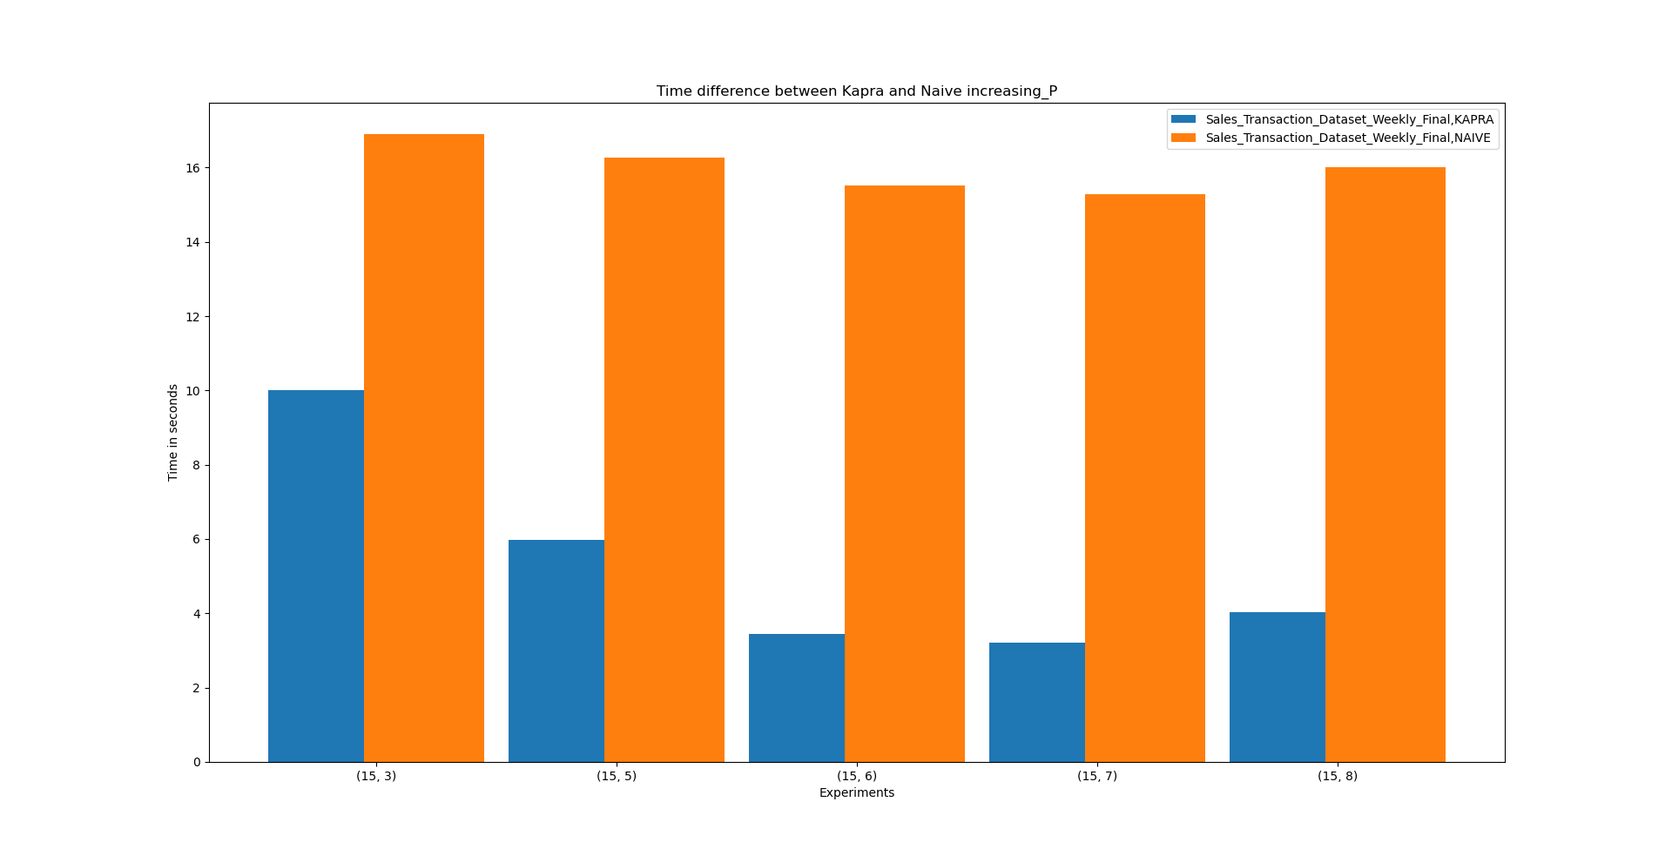

Slide 16
Thanks for the attention

